Slide 1
Linear regression with practical example
Dr. Tirthajyoti Sarkar
August 31st, 2019

Slide 2


Linear regression as a ML problem
Regularization
Model selection
Transformations
Linear regression
Linear regression is used almost as a black box. The most important methods are ‘fit’ and ‘predict’.

Slide 3

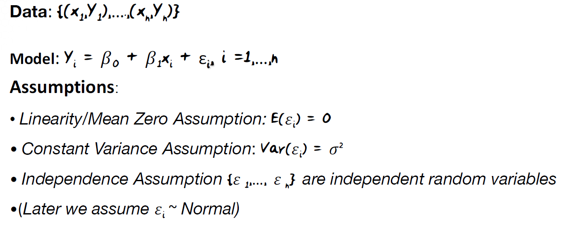
Linear regression as a statistical learning problem
Statistical estimation

Slide 4
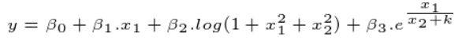
Why linear regression is important to master
Linear regression is pretty flexible and expandable by suitable transformations. Note that linearity is with respect to the coefficients, not the variables themselves.
Generalized linear models follow the same principles as linear regression and can tackle problems related to binary/multi-class classification, Poisson type data (rate dependent phenomena).
Principle of regression is extended for time-series analysis and geo-spatial analysis for tackling a wide range of practical problems.
Linear regression is unmatched in interpretability for business decision making.

Slide 5
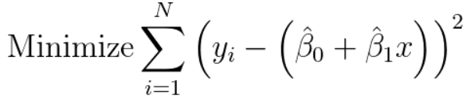
Mechanics of linear regression
We use ordinary least square to solve the linear regression problem.
For a single explanatory variable, our model equation is: y = β₀+β₁.x.
So, β₀ is the intercept and β₁ is the slope of the line. But we can draw many (an infinite number of) lines on the 2-D plane. Which one will we pick as the best?
What is best from a business perspective? In this case, one which gives the least overall error because we believe that if we make least overall error on the given data, then we will make least error in future too.

Slide 6
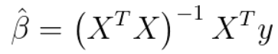

Mechanics of linear regression (continued…)
Why squared error? - There are multiple explanations possible and all are related to deep statistical theory. We will try to examine one of them. It is related to something called ‘Gauss-Markov theorem’ and ‘Maximum Likelihood Estimation’ (MLE).
How do we minimize the sum of the squared errors (find out the least square)? We can use numerical techniques or analytical solution using linear algebra (manipulating matrices and vectors).
The analytical solution is given by, where X is the matrix of data (augmented with 1’s) and y is the response vector :
What is this hat on top of beta? - We will never know the true coefficients, we can only estimate them from the data. We also have to estimate their statistical properties to have confidence in the model.
Notes:
If we are talking about estimation of a parameter from observed data, shouldn’t we also be concerned with the confidence of that estimation, standard errors of the estimation, statistical power of that estimation? Hold that thought, as we will visit these in the next presentation.

Slide 7
Linear regression solved with Scikit-learn
We will work with the wine-quality dataset from UCI ML repository for this demo.
The dataset has been downloaded and saved. We split the dataset in 80:20 ratio, create an estimator object with the ‘LinearRegression’ class from Scikit-learn, and fit the training data. Let’s call this estimator lm.
We can then check the model performance by using the predict method i.e. lm.predict(y_test) and comparing the predictions with the true values (y_test). The root mean squared error (RMSE) is a good metric for regression problems.
We can extract the regression score R^2 using lm.score() method.
If we want to see the full regression equation, we can extract the coefficients and the intercept term with lm.coef_ and lm.intercept_ methods.

Slide 8
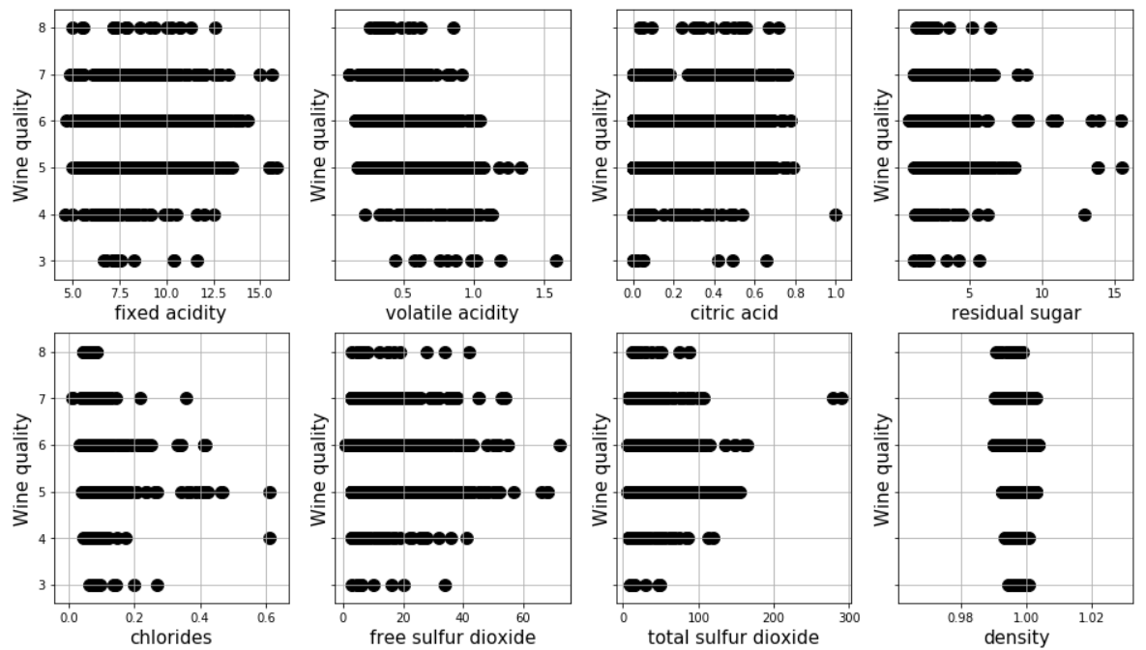
Statistical questions cannot be answered easily
Clearly, not all the predictors have the same impact on the wine quality. How would we investigate?
What are the confidence intervals for the coefficients’ estimates?
How did the residuals look like? Did they satisfy linear regression assumptions?
Was there some collinearity among the predictors which can cause issue?

Slide 9
Linear regression with estimation and inference
Dr. Tirthajyoti Sarkar
August 31st, 2019

Slide 10
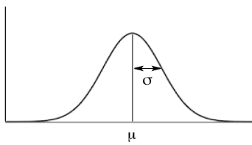
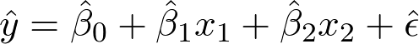
Linear regression as an estimation problem
Random noise
μ = 0
σ² = constant
Confidence intervals
Prediction (with intervals)
Model quality checks
Assumption on the distribution of noise
Uncorrelated
Some process (hidden by nature)
Observed data
Statistical estimation
y = β₀+β₁x₁+β₂x₂+ε
We estimate the model parameters as well as their properties
Assumption that a linear model is a close representation of the process

Slide 11

Linear regression (OLS) assumptions
The regression model is linear in the coefficients and the error term
The error term has a population mean of zero, and a constant variance (no heteroscedasticity)
All independent variables are uncorrelated with the error term
Observations of the error term are uncorrelated with each other
No independent variable is a perfect linear function of other explanatory variables
The error term is normally distributed (optional)

Slide 12
What can go wrong if the assumptions are not met?
If the true process is not linear, and you never verified it properly, then your model will have high bias leading to bad predictive ability. Many non-linearity in the process can be handled with suitable transformations.
If the noise (error) has non-zero mean and non-constant variance, then some ‘portions’ of your model will be ‘more correct’ than the others. Your predictive confidence will be low and non-uniform. Similar issue can result from correlation between noise and predictors.
Linear dependence among predictors may lead to bad numerical solution and extremely wide confidence interval, which makes the predictions useless.
If the error is not normally distributed, then we cannot use standard computations for confidence intervals and p-values. Therefore, we cannot say which parameters are really important.

Slide 13
Do you follow this flow as a data scientist?
Let’s say you, as a data scientist, did the following,
pull the sales data from a database,
perform exploratory data analysis, create nice scatter plots
clean and prepare the dataset for regression modeling, remove outliers
fit it using your favorite machine learning/statistics package (Python, R, JMP, SPSS, MATLAB),
predict future sales,
make recommendation to your boss.
Is anything missing?

Slide 14
You need to look at few more things
Statistical properties of the model coefficients
standard error
p-value
confidence intervals
Residual analysis
Residuals vs. fitted plot
Residuals vs. predictors plot
Histogram and Q-Q plot of the standardized residuals
Multicollinearity plots
Model quality metrics (R², adjusted R², AIC, Mallow’s C_{p})

Slide 15
Residuals, p-values, standard error, Q-Q plot
Residuals: Just the like true model coefficients, we cannot estimate the true error terms either! So, residuals act as proxy. Mathematically, they are just the differences between the predicted values and actual values of the response.
Standard errors (of the coefficients): Just the standard deviation of the coefficients indicating their variability.
p-values (of the coefficients): Probability of the NULL hypothesis that the coefficient is actually zero i.e. has no impact on the response. If p-value is small, the coefficient is statistically significant.
Q-Q plot: Quantile-quantile plot. It is used to judge ‘Normality’ of the error terms by plotting quantiles of the standardized residuals against theoretical quantiles of a standard normal curve.

Slide 16
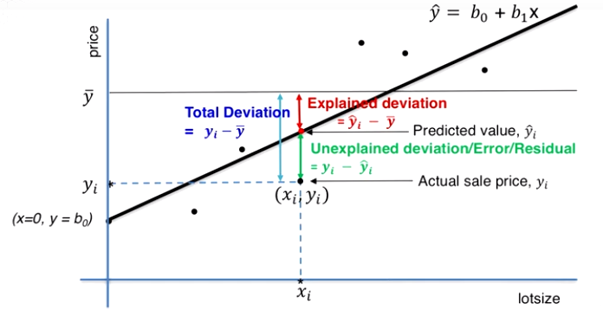
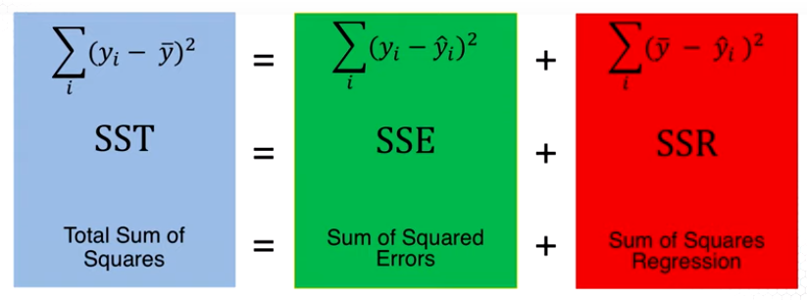
R² and adjusted-R²
Note, R² always increases monotonically if you keep on adding more predictors. Therefore, to penalize insignificant predictors, adjusted-R² metric was developed. We will see the mathematical formula in the Jupyter notebook.

Slide 17
Interpretation of the coefficients
What is the exact interpretation of the coefficients in a multiple linear regression problem (i.e. with more than one variables)?
If a regression model is, y = b₀+b₁x₁+b₂x₂, then it means that,
For a unit change in x₁ variable, y will change by b₁ units, holding x₂ constant.
For a unit change in x₂ variable, y will change by b₂ units, holding x₁ constant.
When both x₁ and x₂ are zero, then the y value will be b₀. Intercept value often turns out to be ‘non-physical’ as x₁, x₂ may never to go zero in a real life situation.
Note, the emphasis on holding x₁ or x₂ constant. This is called marginality. The interpretation of b₁ is marginal on the fact that x₂ is held constant.
Clearly, the sign of the coefficient denote the direction of the relationship. A positive sign means changing by 1 unit increases the response by a positive amount and vice versa.

Slide 18
Let’s do some hands-on coding...
As we saw, machine learning focused libraries like Scikit-learn is not equipped to do all these statistical analyses.
But, we already know the basic mechanics of statistical estimation. We can use packages like Scipy and Numpy to do the analysis ourselves.
If you have used R, SAS, JMP, or SPSS, then you already know what to do!
There is even a better package in Python called Statsmodels, which has a similar flavor as the functions in the language R.
I have created a Python package called MLR, which combines scikit-learn like API but also offers statistical analysis capabilities. We will see this package in action in the Jupyter notebook.

Slide 19
Logistic regression with prediction and inference
Dr. Tirthajyoti Sarkar
August 31st, 2019

Slide 20
Extending the numerical predictions to probabilities
Linear regression is good for predictions where the desired output are real numbers - price, temperature, demand quantity, mechanical or electrical properties, etc.
A large number of predictive analytics cases have the need to predict discrete classes - binary Yes/No type of answers or correct category out of a multitude.
Predicting discrete class/categories can be handled by a variety of machine learning algorithms - support vector machines, k-nearest neighbor, decision trees. Note, they are somewhat different than the regression based models.
To extend statistical estimation/regression idea for classification tasks, we go back to our old friend - probability.
Instead of regress over arbitrary numerical quantities, we regress over probabilities and then pick the maximally probable case as the prediction.

Slide 21

How to turn arbitrary numbers into probabilities?
+∞
Squash!
1
The whole number line
0
-∞

Slide 22
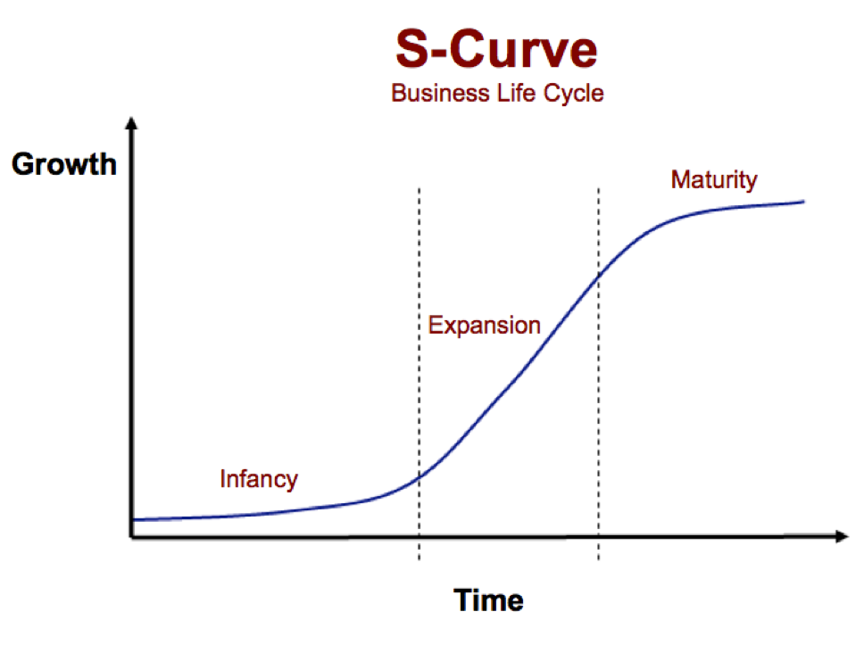
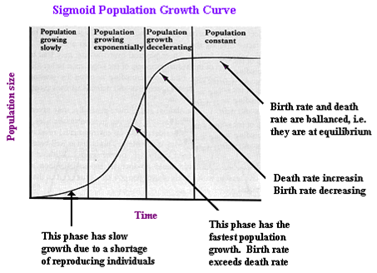
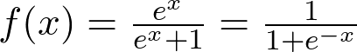
The most important curve of nature (and business)
In business
In biology

Slide 23
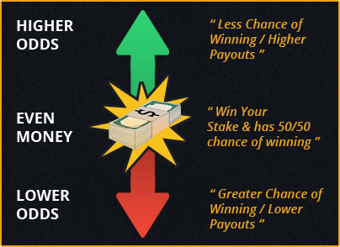

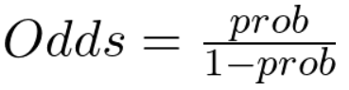
“Do you feel lucky punk, well do ya”?
Regression equation
“Log-odds”

Slide 24
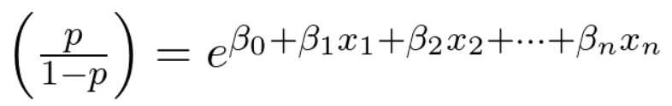
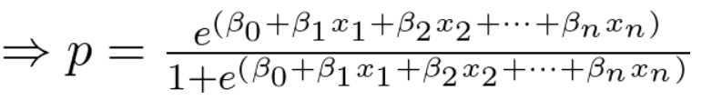
Squashing is done, we can regress over probabilities
Squash!
We maintain the same statistical inference power and interpretations as in the case of linear regression.
However, the error term is not present in this model. The notion of Gaussian error is replaced with something called ‘deviance’.
We can compute standard error, z-statistic, and p-values for the coefficients as before, to check for their statistical significance. Note, we replace t-statistic by z-statistic.

Slide 25
Mechanics of logistic regression
Unlike linear regression, we cannot do a least-square minimization here.
We need to use something called ‘Maximum Likelihood Estimation’ (MLE).
There is no closed-form analytical solution like in the linear regression case. Numerical methods are used. High precision can be achieved nonetheless.
Cross-entropy loss function
OR
Notes:
Hold the MLE in your thought. We will revisit the concept in the last lecture on k-means clustering.

Slide 26
Probability-to-classification
Once we have the probabilities as the regression outputs, it is a matter of determining a threshold what to call YES and what to call NO in a classification problem.
Note, this approach is fundamentally different that similarity-based ML algorithms such as kNN where probabilities need not be computed for classifications.
Where to draw that line in the sand, of course, depends on the problem and the relative cost of making mistakes. A cancer detection algorithm will have quite different probability threshold than a fashion category classification, for example.
This single choice will tweak all the familiar classification metrics - accuracy, precision, recall, false positive/negative rate, etc.

Slide 27
Interpretation of the coefficients
What is the exact interpretation of the coefficients in a logistic regression model?
If a logistic regression model is given by b₀+b₁x₁+b₂x₂, then it means that,
For a unit change in x₁ variable, log odds of the response will change by b₁ units, holding x₂ constant.
For a unit change in x₂ variable, log odds of the response will change by b₂ units, holding x₁ constant.
Note, that the impact here is exponential on the actual odds.
Sign matters. A positive sign means, the ratio of the odds is a number > 1 i.e. odds increases with a +ve change in the predictor variable and vice versa.

Slide 28
Let’s do some coding...
We will look at two examples in the Jupyter notebook. One a

Slide 29
Naive Bayes classification, Maximum Likelihood Estimation (MLE)
Dr. Tirthajyoti Sarkar
August 31st, 2019

Slide 30
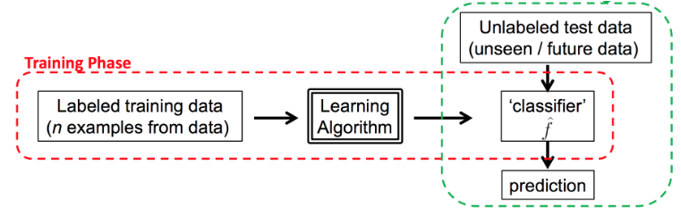
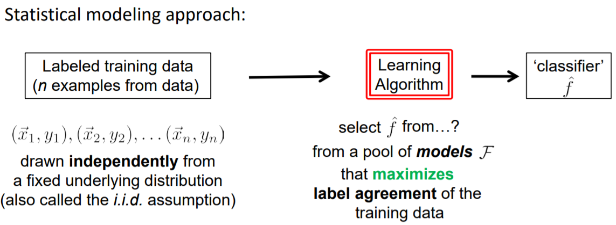
Supervised (statistical) learning
Testing Phase
Image source: http://www.cs.columbia.edu/~verma/classes/ml/lec/lec1_intro_mle_bayes_naive_evaluation.pdf

Slide 31
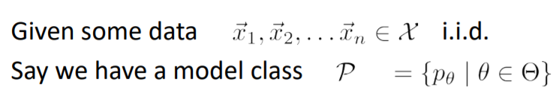
How to select the classifier?
Maximum likelihood (best fits the data)
Maximum a posteriori (best fits the data but incorporates prior assumptions)
Optimization of ‘loss’ criterion (best discriminates the labels)
find the parameter settings θ that best fits the data.
If each model p, is a probability model, then we can find the best fitting probability model via the likelihood estimation!

Slide 32
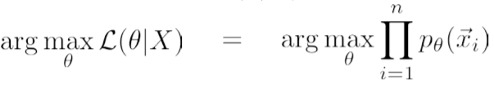
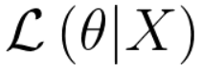
Maximum Likelihood Estimation
Critical assumption - independence. W/O it, math is intractable!
Interpretation: How probable (or how likely) is the data given the model p_{θ}?
Parameter setting θ that maximizes

Slide 33
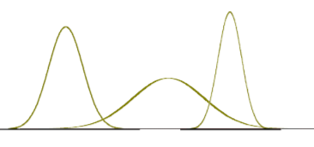
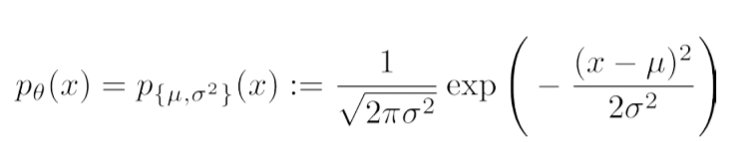
Gaussian example
Suppose we have bunches of price data for a laptop: $650, $575, $870, $690, $735, $675, $715, $745, $655, . . .
Model class (our assumption): Gaussian
μ: Parameter (mean)
σ: Paremeter (std. dev)
So, what is the Maximum Likelihood Estimation given the data?

Slide 34
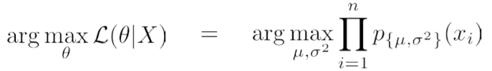
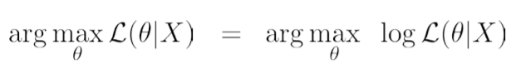
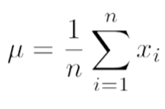
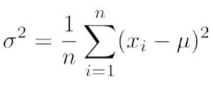
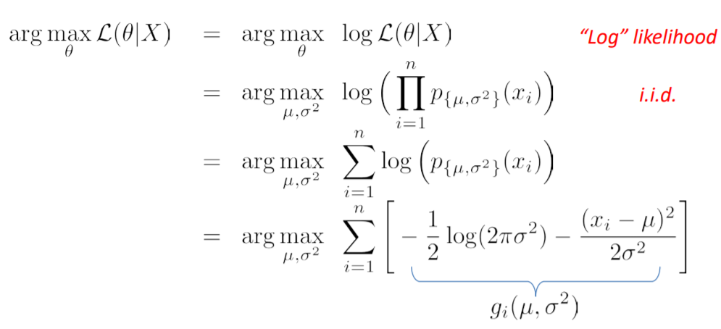
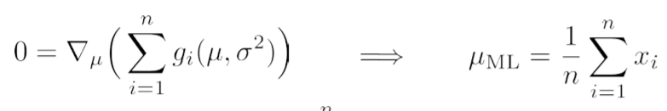
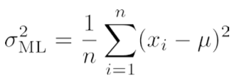
Some math tricks!
So, the best fitting Gaussian model (given the data) is the one with the estimated parameters,
Trick 1
AND
Trick 2
Trick 3

Slide 35
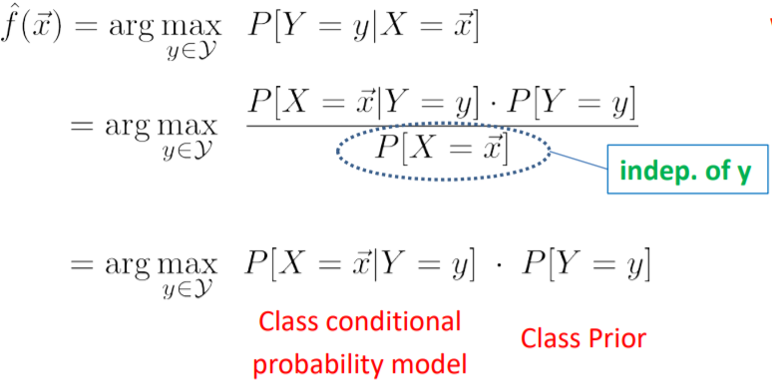
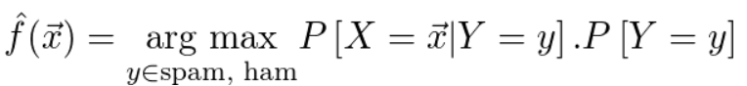
Now an MLE idea utilizing Bayes’ rule
Features
Using labelled data
General frequency of spam/ham

Slide 36
What’s so ‘naive’ in the ‘naive Bayes’?
In Bayes’ rule, the prior is multiplied by the likelihood to get posterior probability. In naive Bayes’ algorithm, the likelihood is the joint probability of features given the label.
Let’s take example of spam emails. The labels are -sapm or ham. Features are words - ‘free’, ‘lottery’, <your best friend’s name>, <latest movie name>, ’Nigerian prince’, etc.
What is the joint probability of these words appearing in an email given the label - spam or ham. That is difficult to determine. But what if we make the assumption that all of those words appear independent of one another? Then the joint probability is just the product of individual probabilities. And individual probabilities can be computed with the frequency of the word in emails.
This assumption of independence is the reason it is called naive. W/O it, solution is almost impossible and the algorithm will not scale to real-life applications.

Slide 37
Let’s do some hands-on coding...

Slide 38
K-means clustering and related concepts - EM, GMM
Dr. Tirthajyoti Sarkar
August 31st, 2019

Slide 39
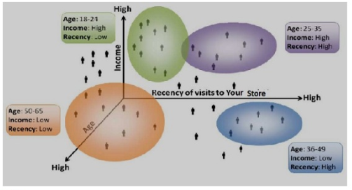
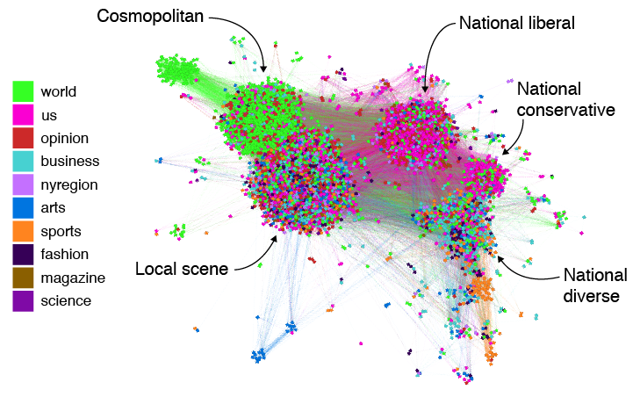
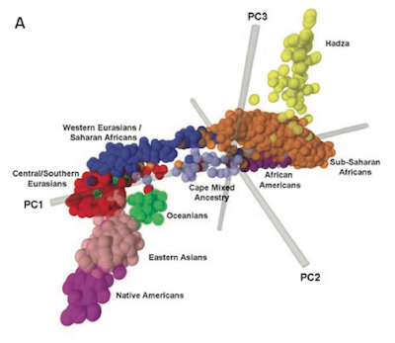
Unsupervised machine learning/clustering
Unsupervised machine learning in contrast to supervised, involves inferring the patterns within datasets without reference to known, or labeled, outcomes.
Two of the main activities in unsupervised ML are: (a) clustering, and (b) dimensionality reduction.
Clustering is an extremely important class of techniques/algorithms for business and scientific applications.

Slide 40
K-means for clustering
The k-means algorithm searches for a predetermined number of clusters within an unlabeled multidimensional dataset.
It accomplishes this using a simple conception of what the optimal clustering looks like:
The "cluster center" is the arithmetic mean of all the points belonging to the cluster.
Each point is closer to its own cluster center than to other cluster centers.
What is the meaning of the word closer? It’s the distance metric which is at the heart of the algorithm. Distance can be simple Euclidean distance, or other complex featurized distance for high-dimensional data like image and audio.

Slide 41
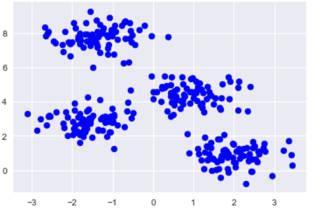
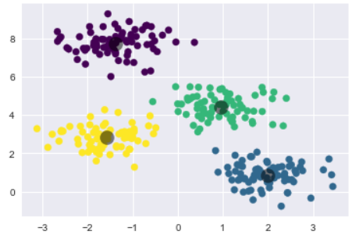
K-means example
Cluster centers

Slide 42
A special case of Expectation-maximization (EM)
Expectation–maximization (E–M) is a powerful algorithm that comes up in a variety of contexts within data science. k-means is a particularly simple and special case of this more general algorithm. The basic algorithmic flow of k-means is to,
Guess some cluster center (initialization)
Repeat following steps until converged,
E-step: assign points to the nearest cluster center
M-Step: set the cluster centers to the mean
Here the "E-step" or "Expectation step" involves updating our expectation of which cluster each point belongs to.
The "M-step" or "Maximization step" involves maximizing some fitness function that defines the location of the cluster centers. In k-means, fitness is just the arithmetic mean.

Slide 43
Convergence, initialization
Under typical circumstances, each repetition of the E-step and M-step will always result in a better estimate of the cluster characteristics.
However, it is best to note that, although the E–M procedure is guaranteed to improve the result in each step, there is no assurance that it will lead to the global best solution.
The initialization is important and particularly bad initialization can sometimes lead to clearly suboptimal clustering.
In fact, almost all canned implementations of k-means (including the scikit-learn version) includes the step of multiple initializations and take the best out of them. This is called k-means++.

Slide 44
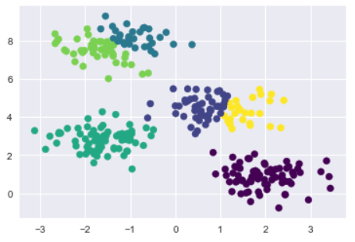
Number of clusters?
Looks weird but k-means cannot resolve this
A common challenge with k-means is that you must tell it how many clusters you expect. It cannot learn the number of clusters from the data.
If we force the k-means to look for 6 clusters instead of 4, it will come back with 6 but they may not be what we are looking for!
Some methods like elbow and silhouette analysis can be used to gauge a good number of clusters.

Slide 45
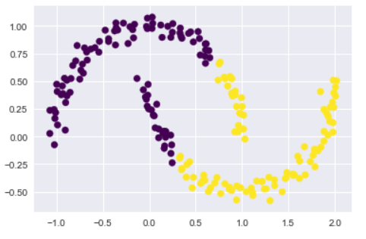
Limitation in terms of geometry
k-means algorithm will often be ineffective if the clusters have complicated geometries.
In particular, the boundaries between k-means clusters will always be linear, which means that it will fail for more complicated boundaries.
It thinks in terms of simple radial distance and circular smooth boundaries, not global patterns.

Slide 46
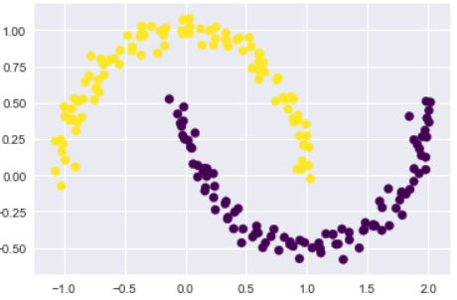
Use kernel/higher dimensional representation?
The situation in the previous slide is reminiscent of the Support Vector Machines, where we use a kernel transformation to project the data into a higher dimension where a linear separation is possible.
Allow k-means to discover non-linear boundaries.
Kernelized k-means is implemented in Scikit-Learn within the SpectralClustering estimator.
It uses the graph of nearest neighbors to compute a higher-dimensional representation of the data, and then assigns labels using a k-means algorithm.

Slide 47
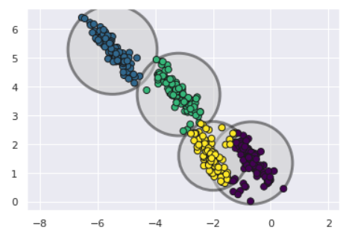
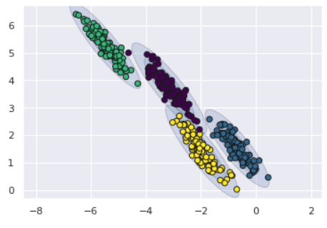
Throwing probability in the mix
Simplicity of k-means is a big advantage for fast processing of large scale data. But this very simplicity also leads to practical challenges in its application.
In particular, the non-probabilistic nature of k-means and its use of simple distance-from-cluster-center to assign cluster membership leads to poor performance for many real-world situations.
Gaussian mixture models (GMMs), can be viewed as an extension of the ideas behind k-means, but can also be a powerful tool for estimation beyond simple clustering.

Slide 48
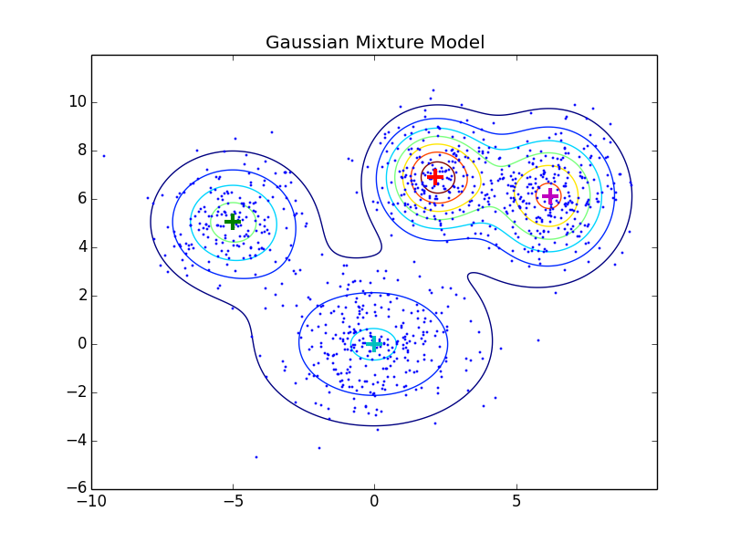
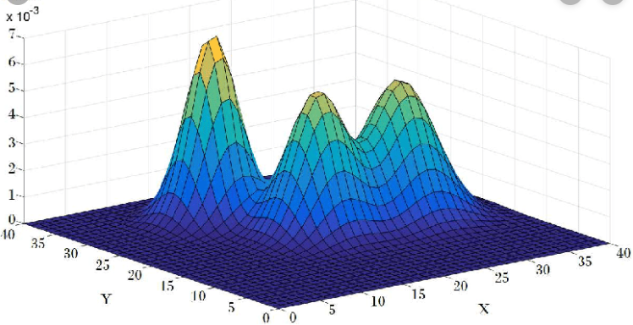
Mixture of Gaussian data...
By running E-M algorithm, estimate the properties of the Gaussians that make up the given data. Guess the ‘centers’ (mean) and spread (std. dev), construct the data, maximize the fitness, recalculate the mean/std dev and repeat.

Slide 49
Let’s do some hands-on coding...
We will generate some synthetic data for easy 2-D visualization and then apply k-means to that data to identify clusters.
We will show the limitations of k-means, and extension to kernelized version, with code.
We will show the idea of Gaussian Mixture Models and also illustrate how its utility extends beyond simple clustering and also to generative modeling.

